Slide 1

COVID-19 Analysis
By Mayuresh Yewale

Slide 2
OBJECTIVE
To analyse and visualize the data of
covid-19 pandemic in visualization and informative way.

Slide 3
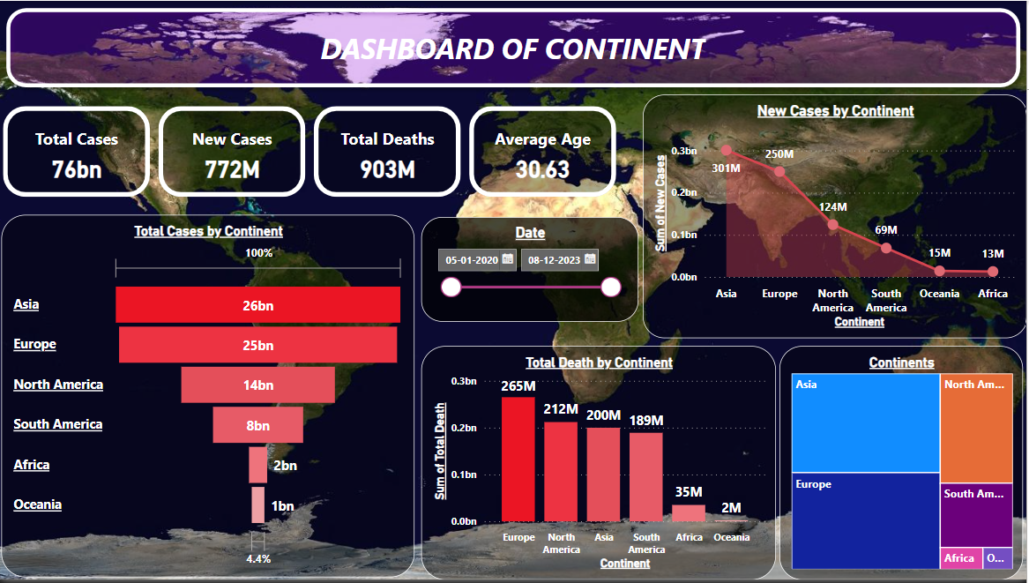
CONTINENT DASHBOARD

Slide 4
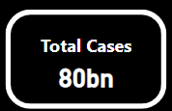

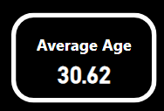
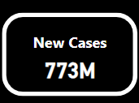
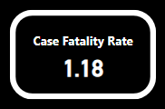
KEY PERFORMANCE INDICATORS(KPI)
Total Corona cases
are 80 Billions
Total Corona Deaths
are 938 Millions
Average age of
Corona Patients are 30.62
Corona New Cases
Are 773 Millions
Case facility Rate
Is 1.18

Slide 5
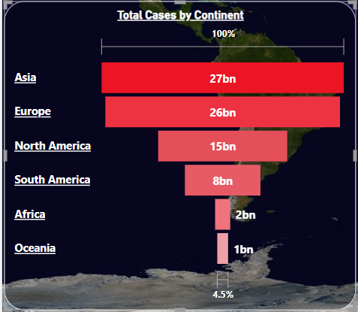
Total cases by Continents
Asia had the most corona cases which are the 27 billions.
After that second highest corona cases continent was Europe which are the 26 billions.
after that third continent was North America which have 15 billions.
at fourth number was Sounth America which have 8 billions.
at second last and last there are Africa with 2 billions and Oceania with 1 billions cases

Slide 6
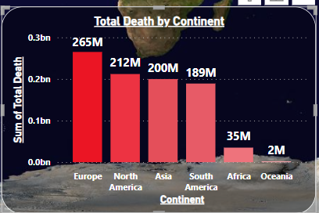
Total Deaths By Continents
Europe have the most death which are 265 Millions .
The Second highest Death continent is North America which was 212 Millions of Deaths.
Third Highest death continents is Asia which was 200 Millions Deaths
The Fourth death Continents is Scouth America which was 189 Millions Deaths.
The Fifth death continent is Africa which was 35 millions Deaths.
The sixth deaths Continent is Oceania Which was less 2 millions Deaths

Slide 7
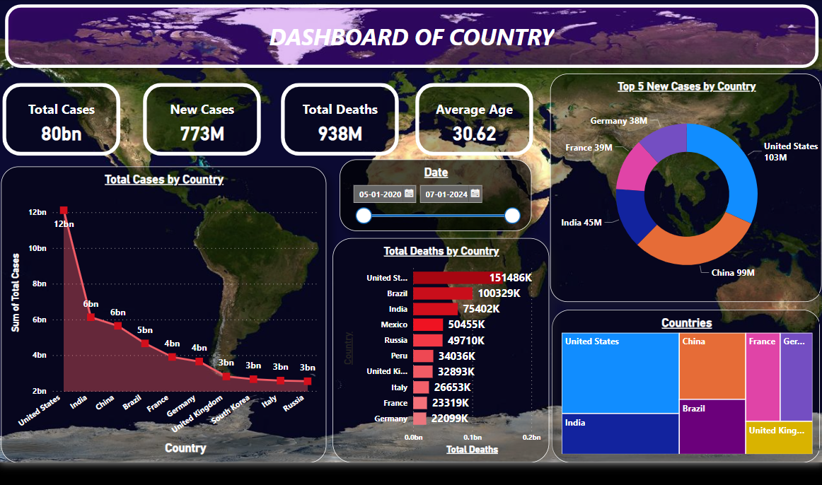
COUNTRY ANALYSIS

Slide 8
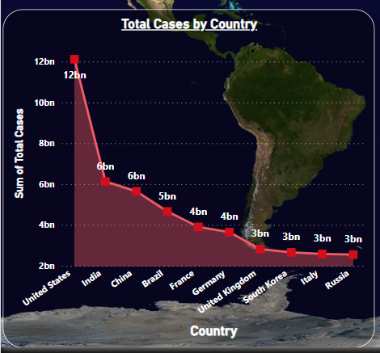
Totals Cases by Countries
United states had the most corona cases
which was 12 Billions cases.
second highest corona cases country was India which was 6 Billions cases.
Third highest corona case country was
China which has 5 Billions cases.
Fourth Highest Corona cases Country was
Brazil which has 4 Billons cases.
Fifth Highest Corona cases Country was
France which has 3 Billions Cases

Slide 9
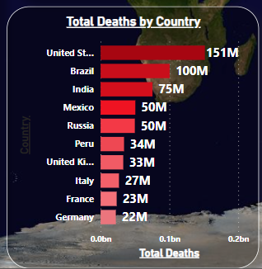
Totals Deaths by Countries
First highest Death Country is United State which has 151 Millions of Deaths.
Second Highest Country for Deaths is Brazil Which has 100 Millions of Deaths.
Third Highest Country for Deaths is India Which has 75 Millions deaths of peoles.
Fourth Highest Country for Deaths is Mexico Which has 50 Millions deaths of peoles.

Slide 10
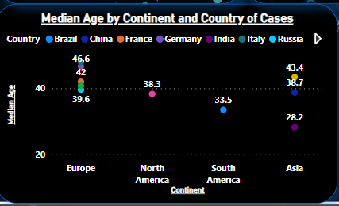
Average age by Countries and continents
Europe Continent:- Russia has 39.6 ,France and united state has 42, Germany has 46.60 and Italy has 47.90 median Age of Patients.
North America:-United state has 38.3 median Age of Corona Patients.
South America:- Brazil has 33.5 Average age of corona Patients.
Asia:-India has 28.20 , China Has 38.20 and South Korea had 43.40 average age of patients

Slide 11

Covid -19 Dashboard

Slide 12
Conclusion
my data visualization provides the insights of death tolls total cases in which
it can help in Analysing and contributing to strategic decisions.
United State had the most corona patients as well as the most deaths
Also.
Asia Continent had the most Corona patients. And Europe continent had the most
Corona Deaths.
Covid-19 affected health systems, economies, and daily lives in nearly every country.
This is all had conclude thoughout the report.

Slide 13
THANK YOU
By Mayuresh Yewale

